Slide 1

Probability and Statistics
Han Min(hanm@bjut.edu.cn)
Office：3414 The Second Experimental Building
College of Applied Sciences
Beijing University of Technology
100124, Beijing P. R. China

Slide 2
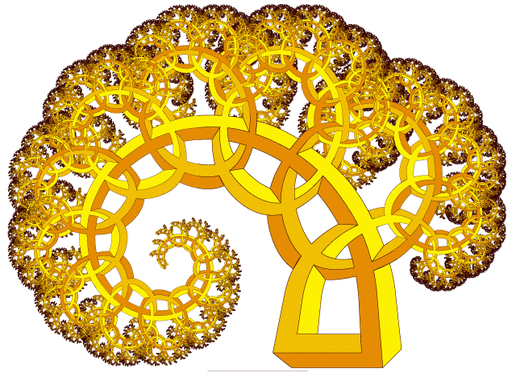
Chapter 7. Parameter Estimation
7.1 Point Estimation
7.2 Evaluation Standard for Estimations
7.3 Interval Estimation

Slide 3
Contents
7.2 Evaluation Standard for Estimations
Unbiasedness
Unbiasedness
7.2.1
MSE Criterion
7.2.2

Slide 4


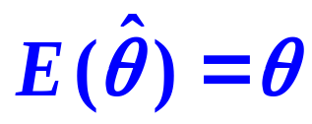
7.2.1 Unbiasedness
Definition
Unbiasedness
An estimator is an unbiased estimator of a parameter θ if for every possible ,the following statement is true:

Slide 5
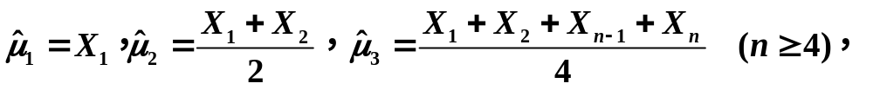
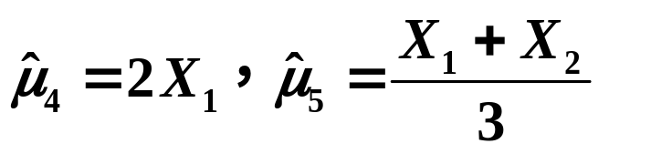
7.2.1 Unbiasedness
Example 1
Suppose the mean of X is μ, μ is unknown.
Considering five estimators of μ:
are biasedness or un biasedness.

Slide 6


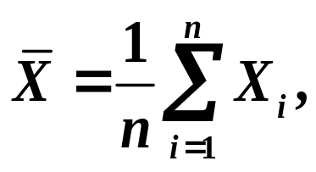
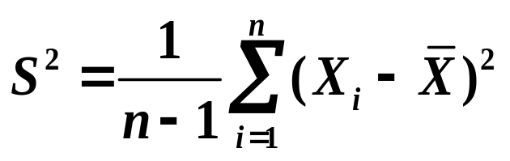
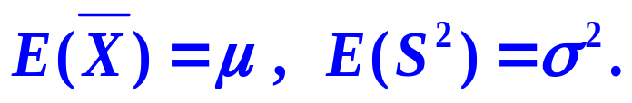
7.2.1 Unbiasedness
Theorem 7.2.1
Suppose the mean of X is μ, and the variance
is σ², both of them are unknown.
and are sample mean and sample variance.
then

Slide 7
7.2.1 Unbiasedness
Example 2
Suppose the mean of X is μ, and the variance
is σ², both of them are unknown.
Proving estimator sample standard deviation S
is biased of σ .

Slide 8
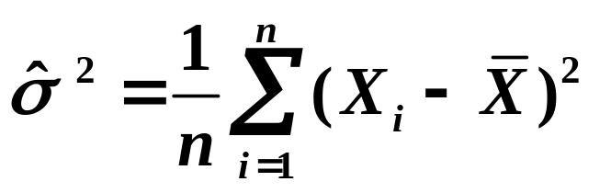
7.2.1 Unbiasedness
Example 3
Suppose the mean of X is μ, and the variance
is σ², both of them are unknown.
Proving estimator
is biased of σ² .

Slide 9
Contents
7.2 Evaluation Standard for Estimations
Unbiasedness
7.2.1
MSE Criterion
MSE Criterion
7.2.2

Slide 10
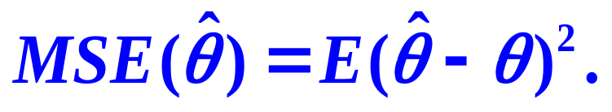
7.2.2 MSE Criterion
Definition
MSE

Slide 11
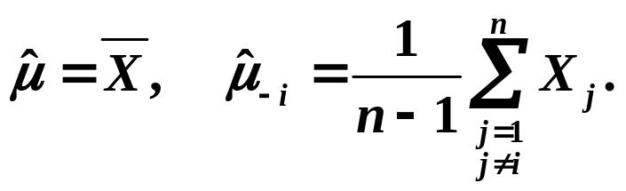
7.2.2 MSE Criterion
Example 1
Suppose the mean of X is μ, μ is unknown.
Considering two estimators of μ:
Which one is better?

Slide 12
Chapter 7. Parameter Estimation
7.1 Point Estimation
7.2 Evaluation Standard for Estimations
7.3 Interval Estimation

Slide 13

7.3 Interval Estimation
Example
The fuel consumption of the cars
When study on µ the average fuel consumption of the
domestic cars per km,
if the MLE of µ is 9.9,
but in practice
we known, the true value of µ may be greater than 9.9,
may also be less than 9.9.
So we can give a range in interval estimation, we reasonably believe the true value of µ is located in this range,
and give
the “reliability” of the true value of µ is located in this range.
Confidence Level

Slide 14



7.3 Interval Estimation
In other words, the higher confidence level, the more confidence to believe the true value of the unknown parameter falls in this interval.
we record the confidence level as
is a very small positive number,
we refer this
range as the confidence intervals.

Slide 15



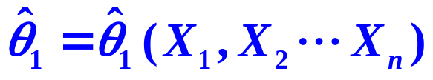
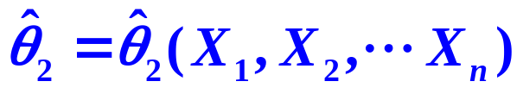
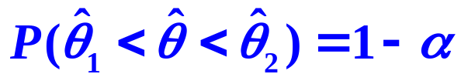
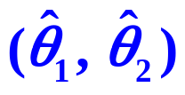
7.3 Interval Estimation
Definition
confidence intervals
Suppose is a unknown parameter.
For a given
if two estimators determined by the sample
and
satisfies
then the random interval
is called a confidence interval.

Slide 16
Contents
7.3 Interval Estimation
Confidence intervals for the mean
of a Normal Distribution
Confidence intervals for the mean
of a Normal Distribution
7.3.1
Confidence intervals for the variance
of a Normal Distribution
7.3.2
Confidence intervals of two Normal Distributions
7.3.3

Slide 17




7.3.1 Confidence intervals for the mean
of a Normal Distribution
Question
Suppose is a sample from .
Find the confidence interval for µ with confidence level
1
is known;
2
is unknown;

Slide 18


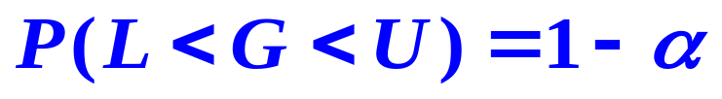
7.1.2 Maximum Likelihood Estimation
Steps
U contains
The distribution of G does not contain
Find of :
1
Construct a pivotal quantity G；
2
Solve to find L, U；
3
Find .

Slide 19

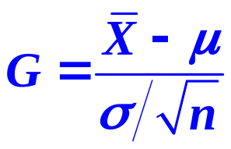
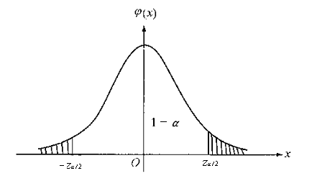

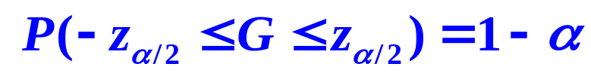
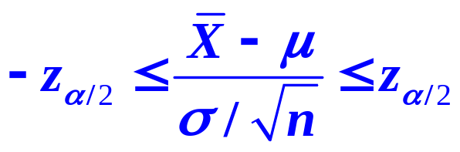

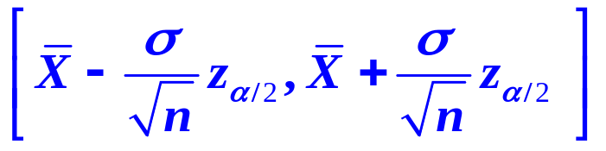
7.3.1 Confidence intervals for the mean
of a Normal Distribution
Find the confidence interval for µ with confidence level
1
is known
Solution:
~ N ( 0, 1 )，
so the confidence interval for µ with confidence
level is:

Slide 20


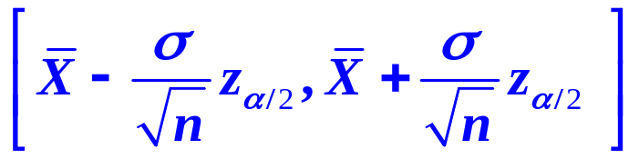
7.3.1 Confidence Intervals for the mean
of a Normal Distribution
Example 1
A laboratory measure the proportion of aluminum 16 times, the average value is
Suppose the population
Find the confidence interval of µ with confidence level 95%.
Solution:
the confidence interval for µ with confidence
level is:
(2.691, 2.719).

Slide 21
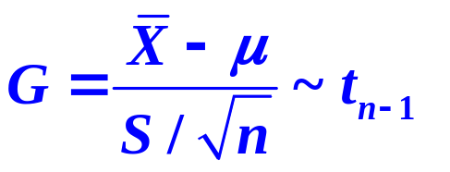

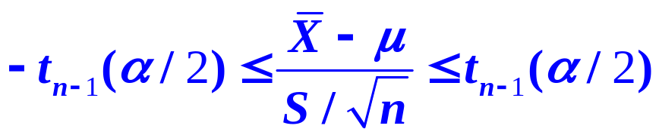
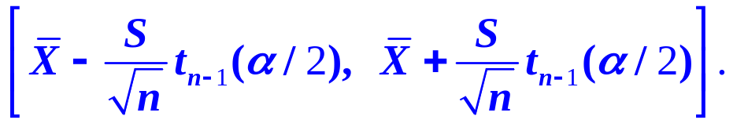
7.3.1 Confidence intervals for the mean
of a Normal Distribution
Find the confidence interval for µ with confidence level
2
is unknown
Solution:
so the confidence interval for µ with confidence
level is:

Slide 22


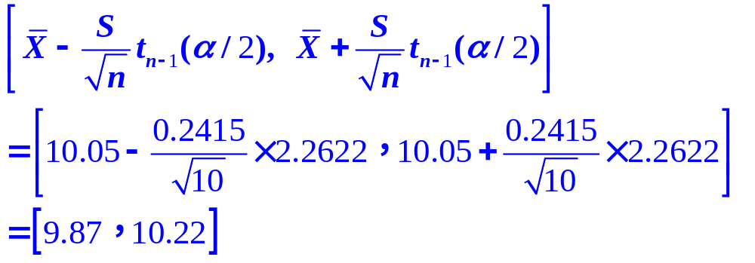
7.3.1 Confidence Intervals for the mean
of a Normal Distribution
Example 2
In order to estimate the weight of a product, we measure
it 10 times:
10.l, 10.0, 9.8, 10.5, 9.7, l0.l, 9.9, 10.2, 10.3, 9.9.
Suppose the population to be tested follows
are both unknown.
Find the confidence interval of µ with confidence level 95%.

Slide 23
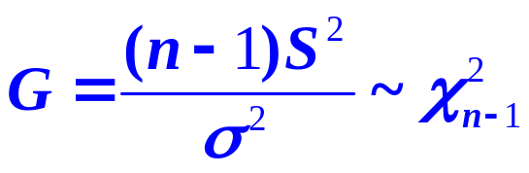

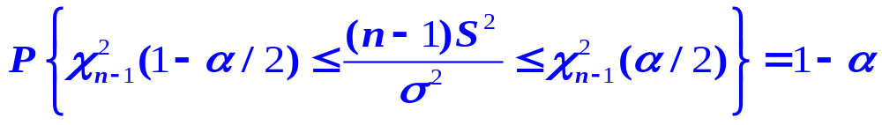
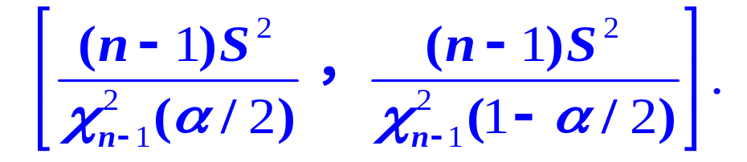
7.3.1 Confidence intervals for the mean
of a Normal Distribution
Question
Suppose is a sample from .
Find the confidence interval for σ² with confidence level
so the confidence interval for σ² with confidence
level is:

Slide 24
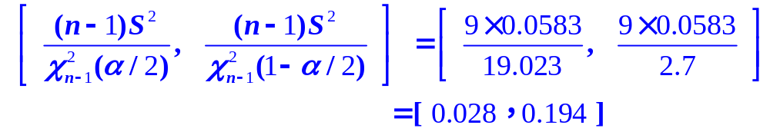
7.3.1 Confidence Intervals for the mean
of a Normal Distribution
Example 3
In order to estimate the weight of a product, we measure
it 10 times:
10.l, 10.0, 9.8, 10.5, 9.7, l0.l, 9.9, 10.2, 10.3, 9.9.
Suppose the population to be tested follows
are both unknown.
Find the confidence interval of σ² with confidence level 95%.

